Slide 1
SHUL APPLICATION

Slide 2
Purpose:
Store, retrieve, and manipulate data from a database

Slide 3
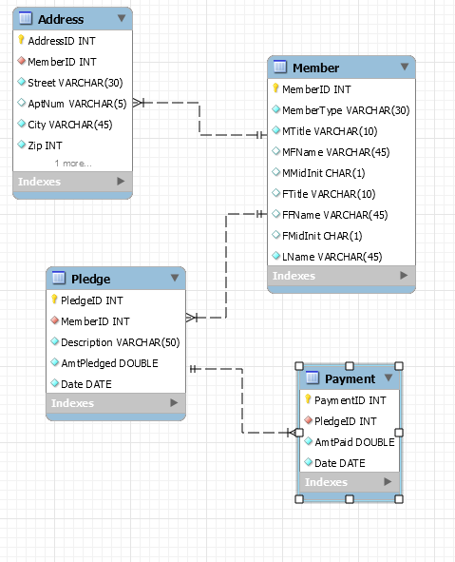
Our First ERD…

Slide 4
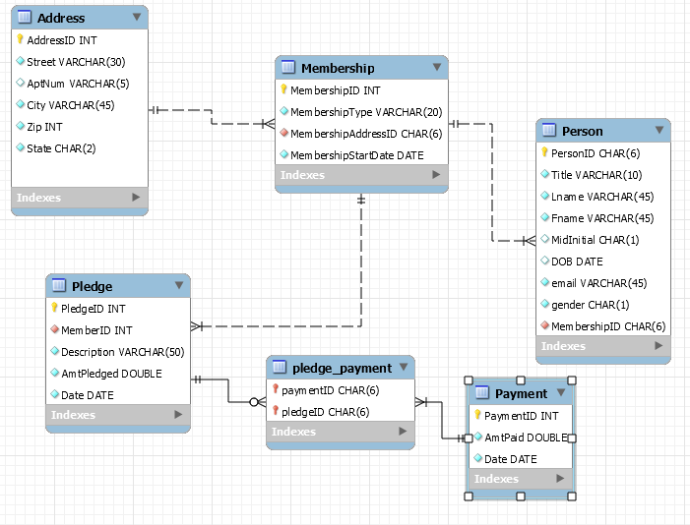
We’ve Come a Long Way

Slide 5
SQL…JAVA…Together now!
Difficulties:
Connecting the database to java
Login, rights to DBs
Firewall
Updatable, Scrollable

Slide 6
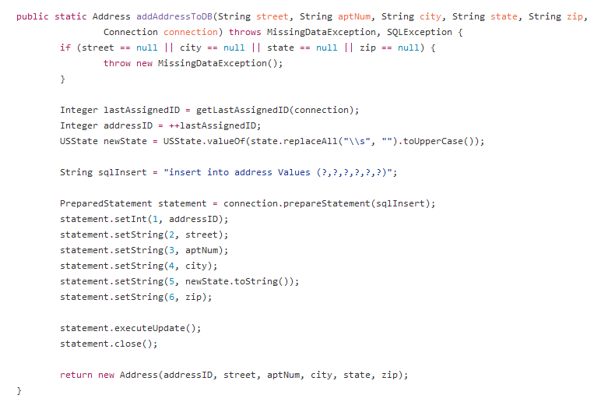
Sample method to insert data into database
The Connection String that Worked

Slide 7
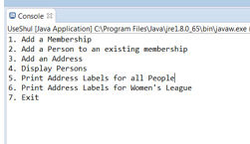
Here’s how it works:

Slide 8
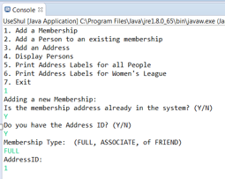
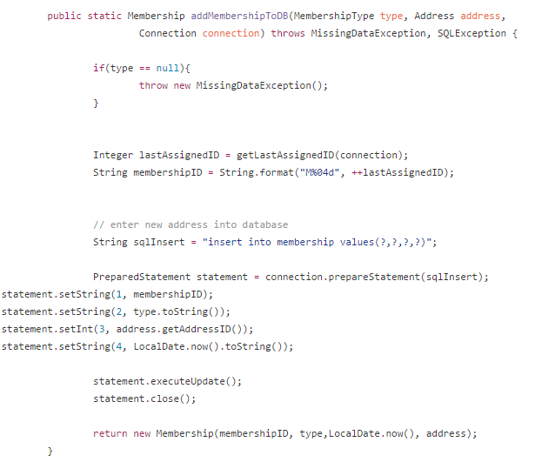

Slide 9
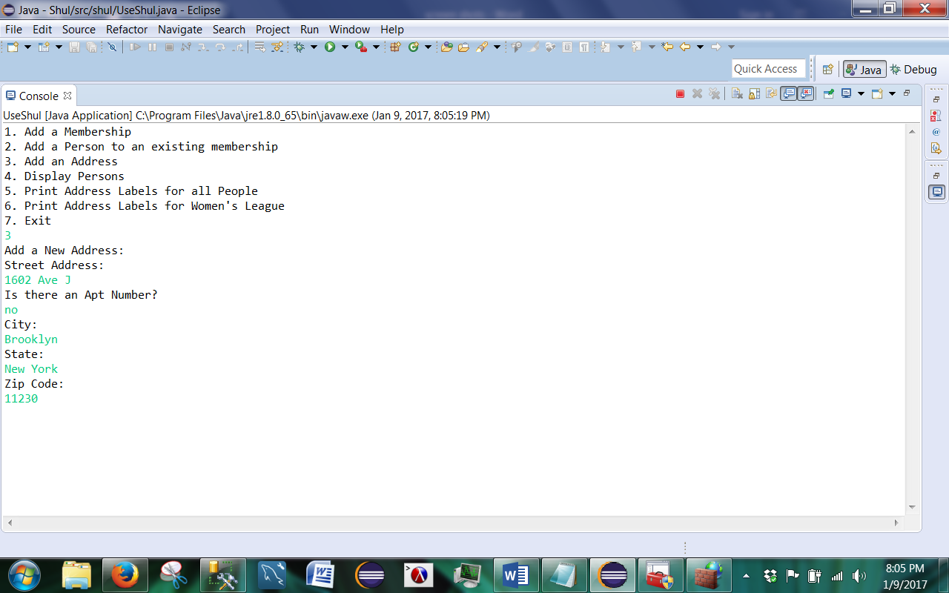
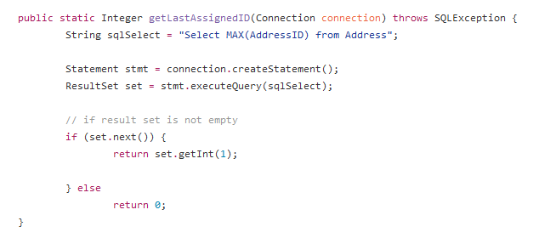

Slide 10
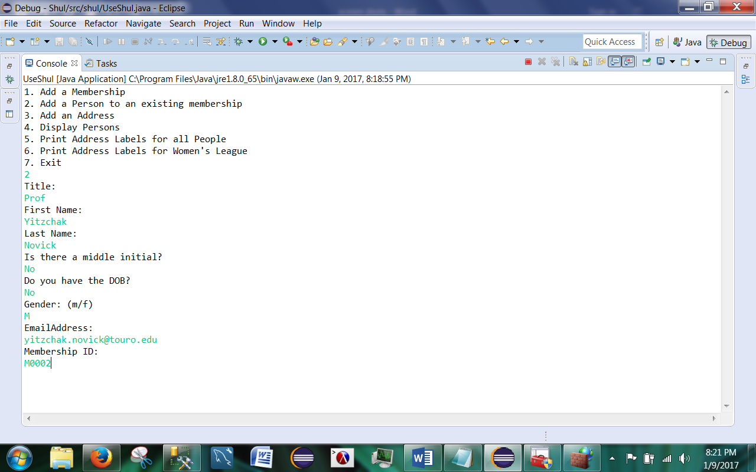
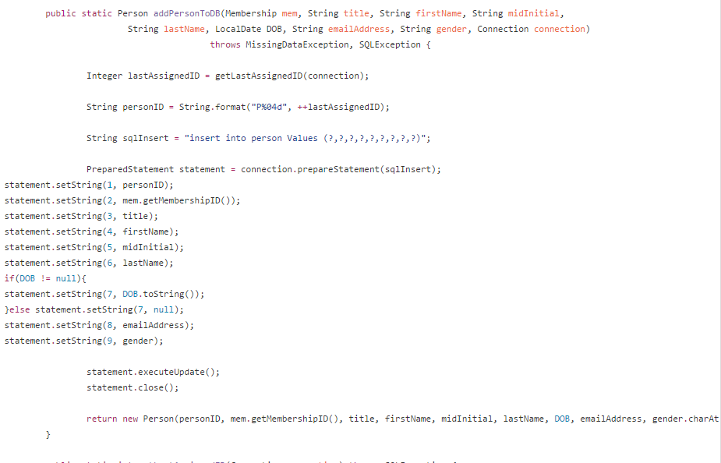

Slide 11
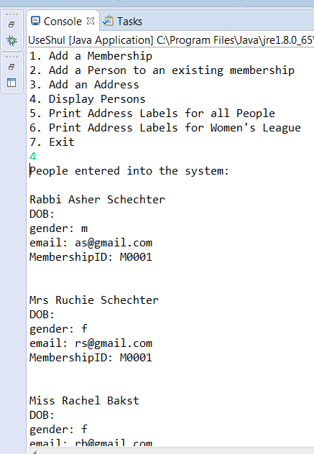
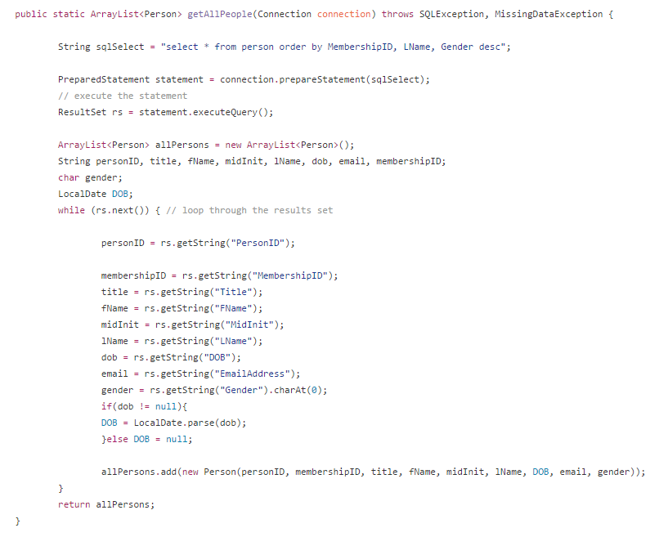

Slide 12
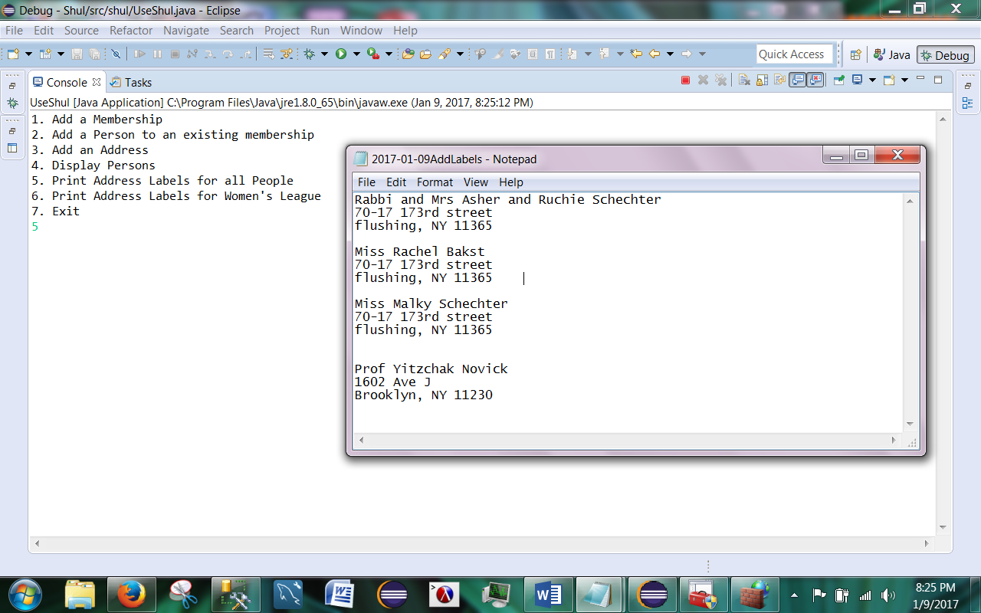

Slide 13
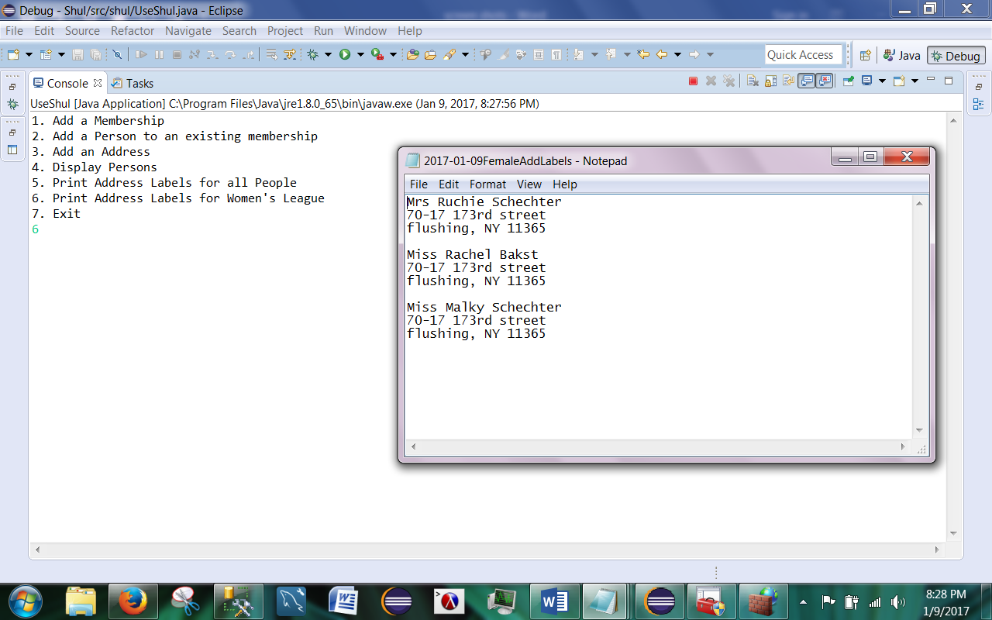

Slide 14
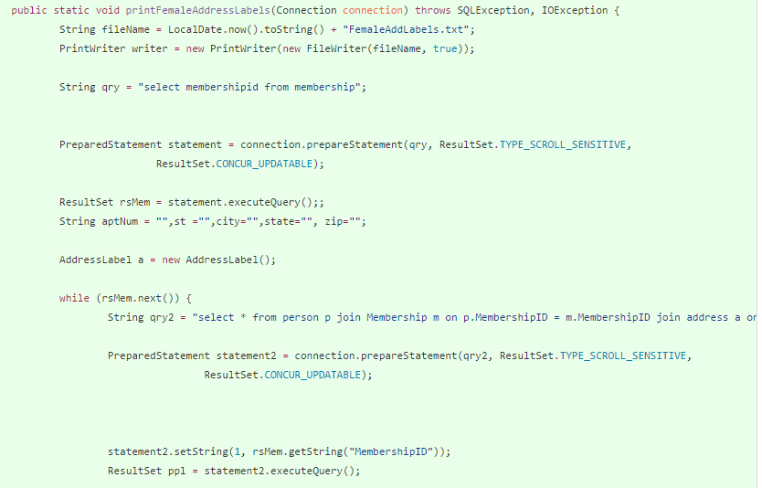
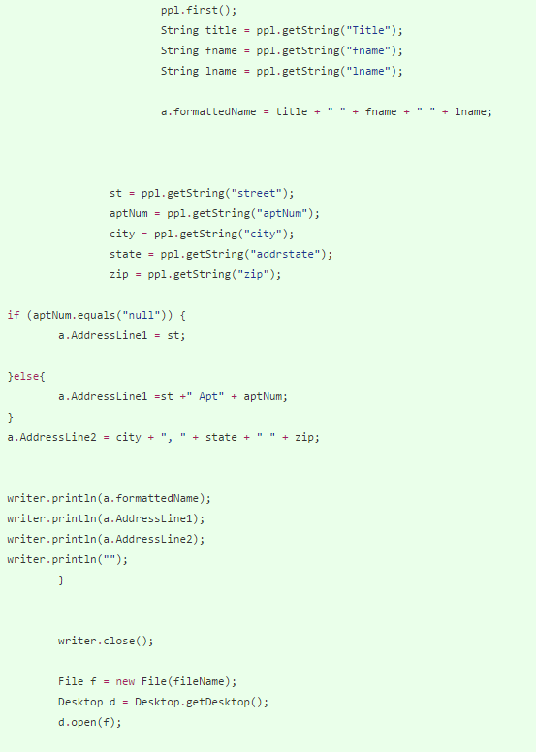

Slide 15
Room For Growth
Pledge Table
Payments/Installments
Events

